Slide 1
The Maze using Depth-First Traversal
Kaustuv Giri

Slide 2
Table of Content
Abstract
Introduction
Design
Implementation
Test
Conclusion
References

Slide 3
Conclusion
DFS effectively navigates mazes from start to destination.
Visited set optimizes exploration and avoids revisiting cells.
Concise implementation makes DFS a versatile and reliable maze-solving technique.

Slide 4
Abstract
Objective: Efficiently traverse mazes using DFS algorithm.
Method: Implement concise and elegant DFS solution for maze navigation.
Scope: Explore diverse maze configurations and assess DFS performance.
Achievements: Successfully traverse mazes with rigorous testing.
Results: Showcase DFS efficiency and reliability in complex mazes.
Conclusions: Provide insightful findings and future recommendations.

Slide 5
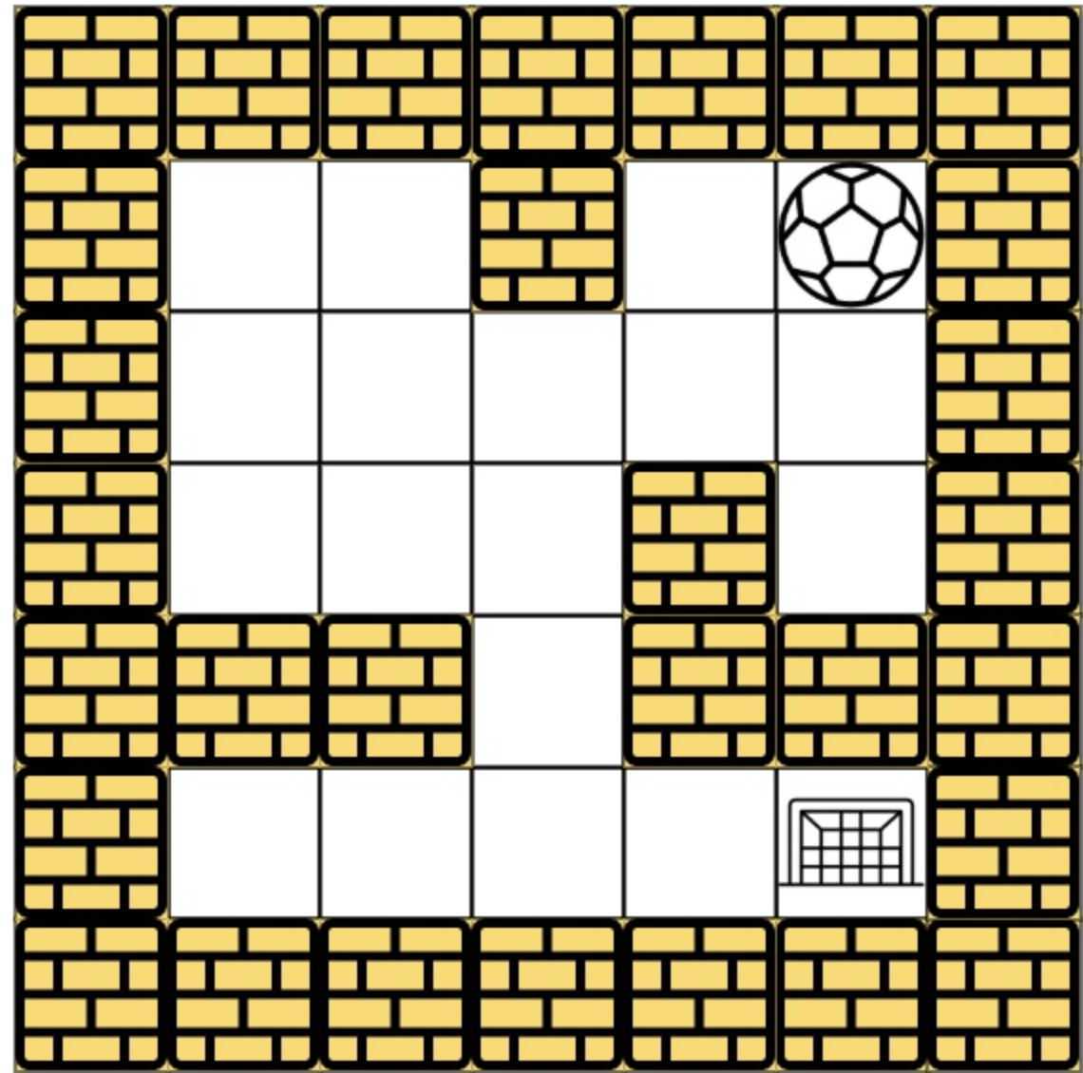
Introduction
Project Objective: Traverse from starting point to finishing line inside a maze.
Approach: Utilize Depth-First Search (DFS) algorithm for efficient maze traversal.
Concise Implementation : Accomplish the maze-solving goal with an elegantly concise implementation, highlighting the power of DFS.

Slide 6
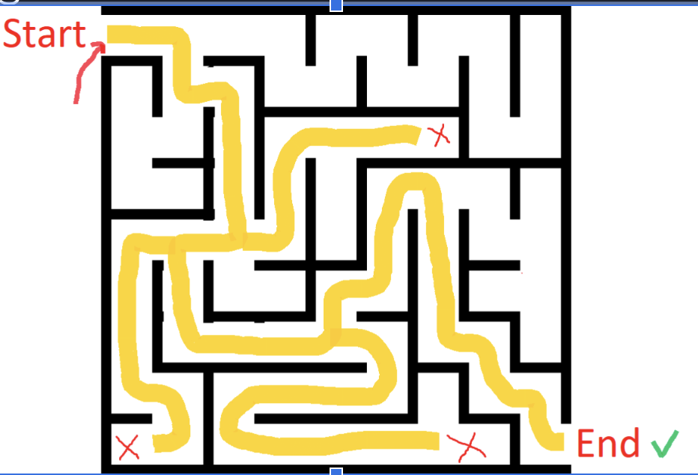
Design
Can DFS successfully traverse through a maze?
Inshort, Yes! This DFS technique is a powerful way to explore and find a path within complex mazes.
In DFS, the ball can move through the sequence as: Right -> Left -> Up -> Down
The method involves exploring the maze by moving in a single direction as far as possible until reaching a dead-end or the destination. At each step, we mark the current cell as visited to avoid re-exploring the same path.

Slide 7
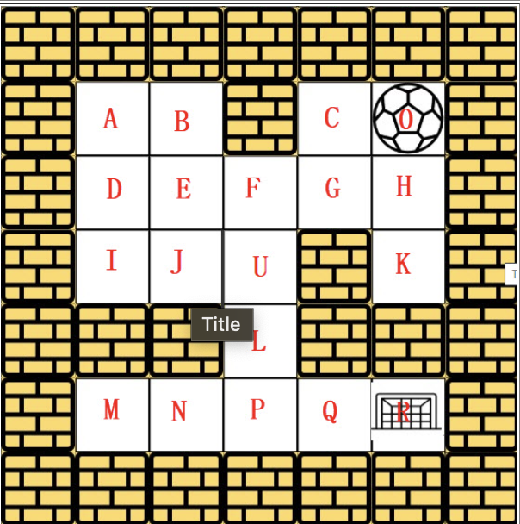
Design
Convert a maze into a graph by representing cells as vertices and walls as edges.
Identify and represent walls of each cell in the maze as edges in the graph.
Create vertices for each cell, connecting neighboring vertices with edges representing walls.
Connect open spaces (corridors) by adding edges between corresponding vertices.
Handle loops or cycles by adding necessary edges to represent them in the graph.

Slide 8
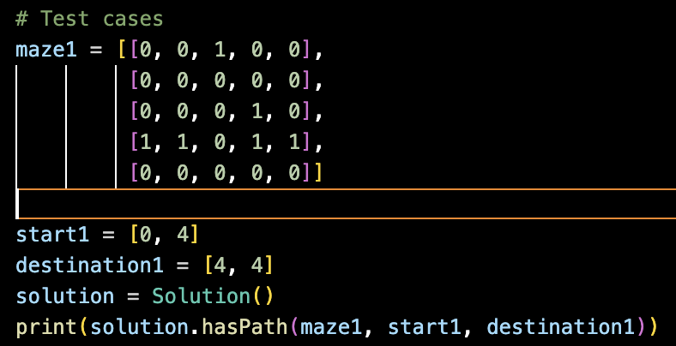
Implementation
Represent the cells as 2D matrix
Input the starting and the ending position

Slide 9
Implementation in summary
The class Solution contains methods to traverse the maze and check if there exists a path from the starting point to the destination.
The DFS approach is used to explore potential paths in the maze by moving in four directions (up, down, left, right).
Utilize a visited set to keep track of explored cells during maze traversal.
Initialize the visited set as an empty set before starting the DFS traversal.
Add the coordinates of each explored cell (start) to the visited set to avoid revisiting.

Slide 10
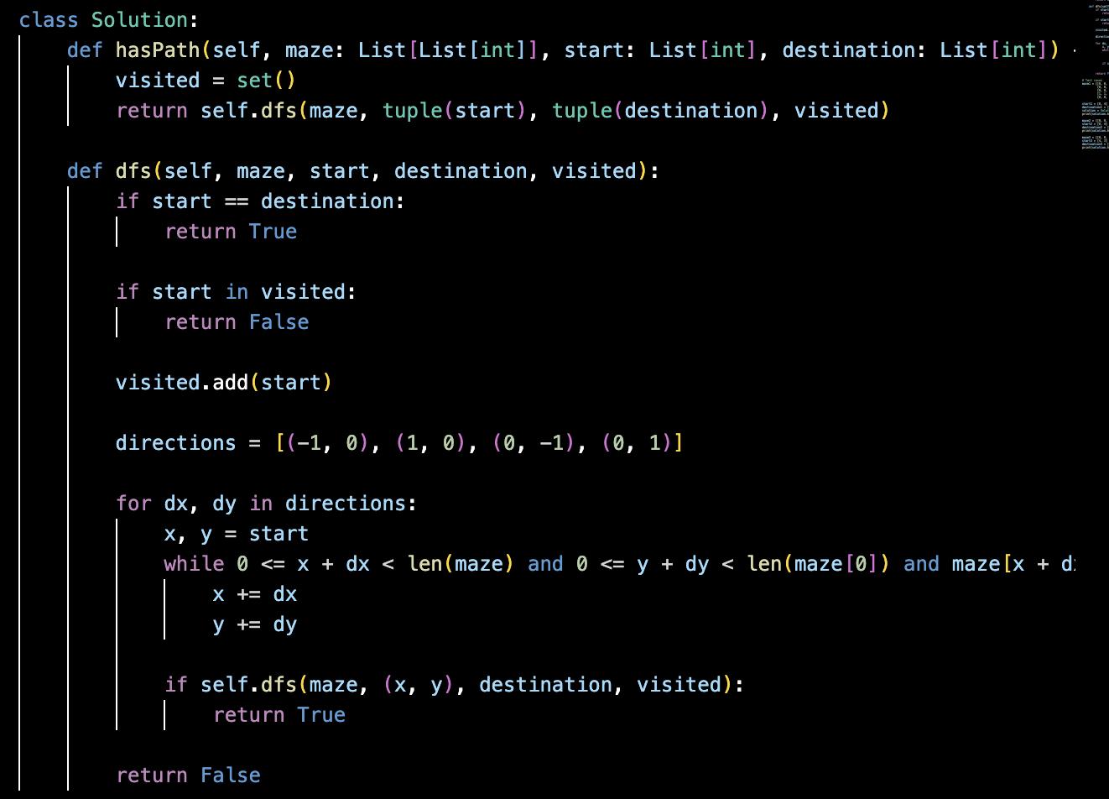
Algorithm

Slide 11
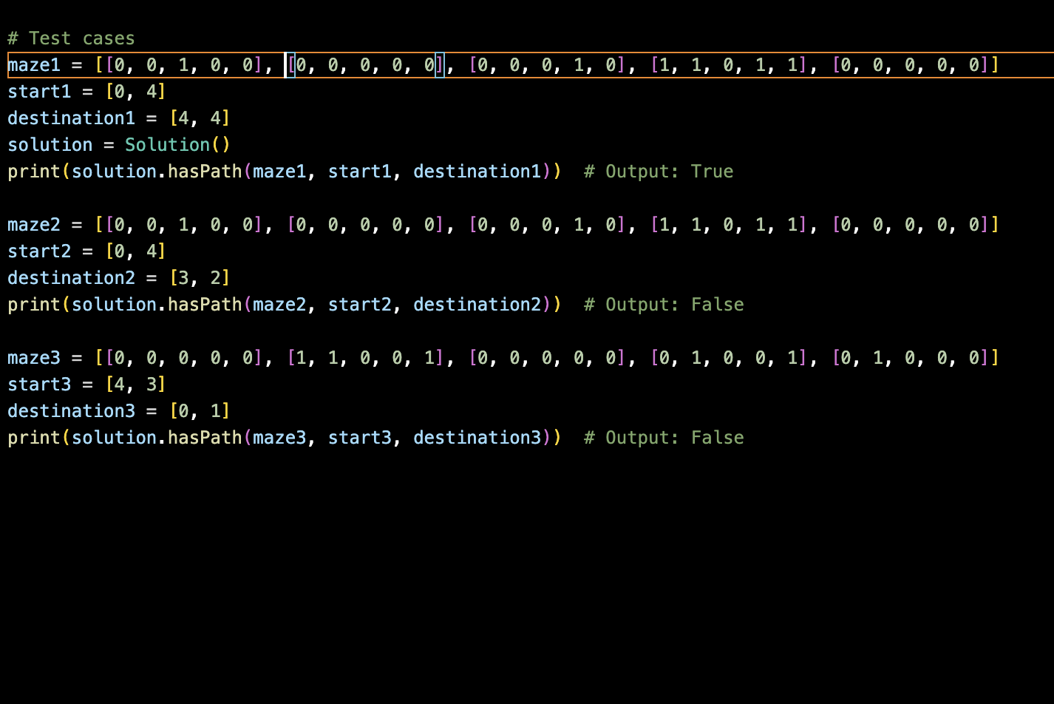
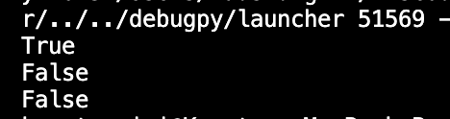
Test Cases

Slide 12
References
Leetcode
Prof Henry Chang website
ChatGpt How to solve DFS maze using python

